Slide 1
Lending Club Case Study
Exploratory Data Analysis
By
Jyothsna Devi
Sujai Jain

Slide 2
Objective
It helps developing basic understanding of risk analytics in banking and financial services and understand how data is used to minimize the risk of losing money while lending to customers.
It helps a Bank to make a decision for loan approval based on the applicant’s profile.
Using EDA we can understand how consumer attributes and loan attributes influence the tendency of default.

Slide 3
Constraints
When a person applies for a loan, there are two types of decisions that could be taken by the company:
Loan accepted: If the company approves the loan, based on 3 possible scenarios described below:
Fully paid: Applicant has fully paid the loan (the principal and the interest rate)
Current: Applicant is in the process of paying the instalments, i.e. the tenure of the loan is not yet completed. These candidates are not labelled as ‘defaulted’.
Charged-off: Applicant has not paid the instalments in due time for a long period of time, i.e. he/she has defaulted on the loan
Loan rejected: The company had rejected the loan because the candidate does not meet their requirements etc.,

Slide 4
Data Cleaning and Preparation Process
Import Data from csv
Data cleaning is the process of removing data which are not contributing for analysis
Removing null , NA values
Remove loan status with value ‘Current’
Remove unique values
Remove behavioural columns

Slide 5
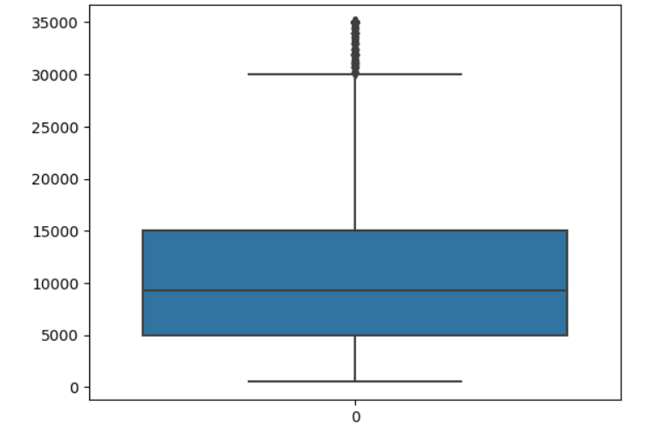
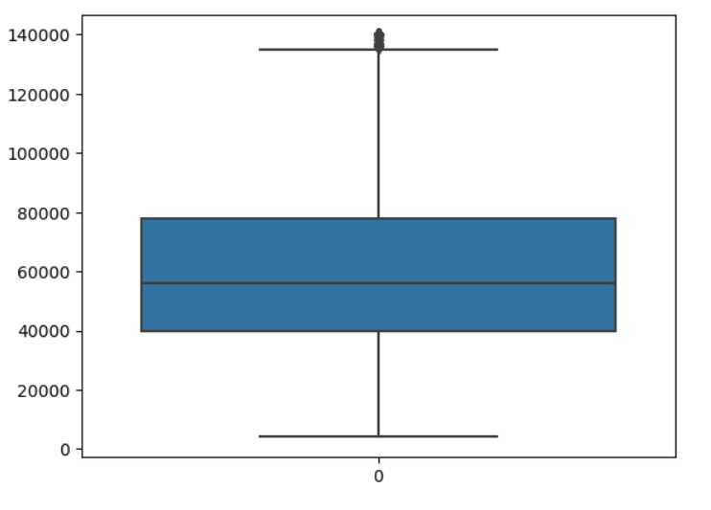
Univariate Analysis
Most of the loan amount applied was in range of 5000-14000
Annual income of most of the applicants is in the range of 40000 – 750000

Slide 6
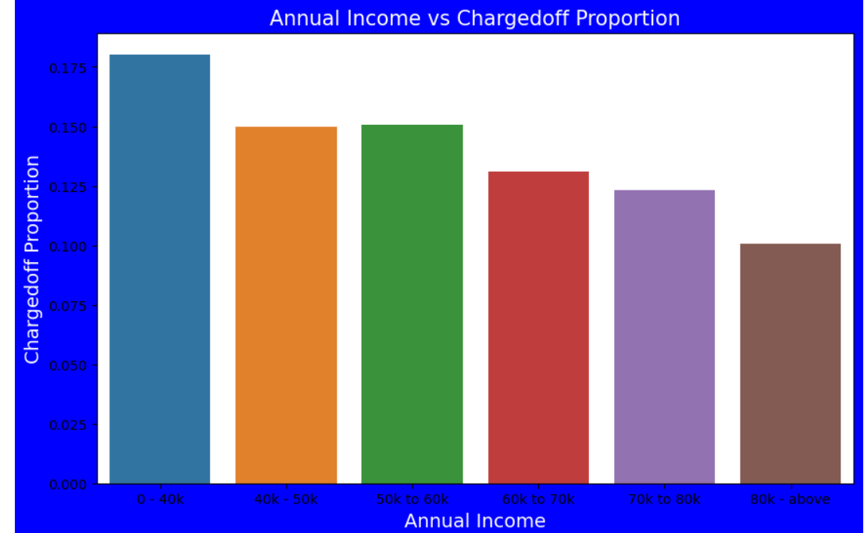
Bivariate Analysis
Increase in annual income decrease Charged Off proportion

Slide 7
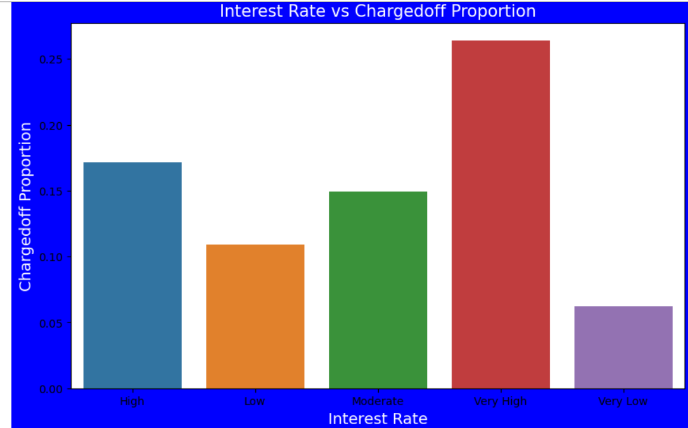
Interest Rate Vs Charged Off
Charged off proportion is increasing with higher interest rates
Interest rate less than 10% has very less chances of charged off.
Interest rate more than 16% has high chances of charged proportion.

Slide 8
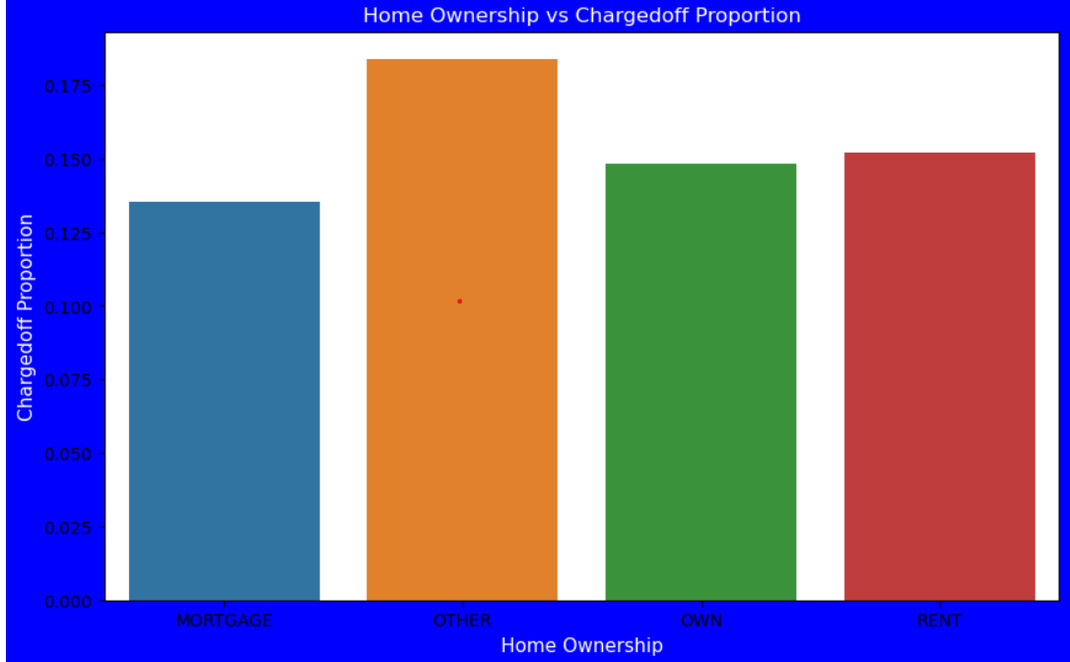
Home Ownership Vs Charged Off
Those who are not owning home have high chances of loan defaulter.

Slide 9
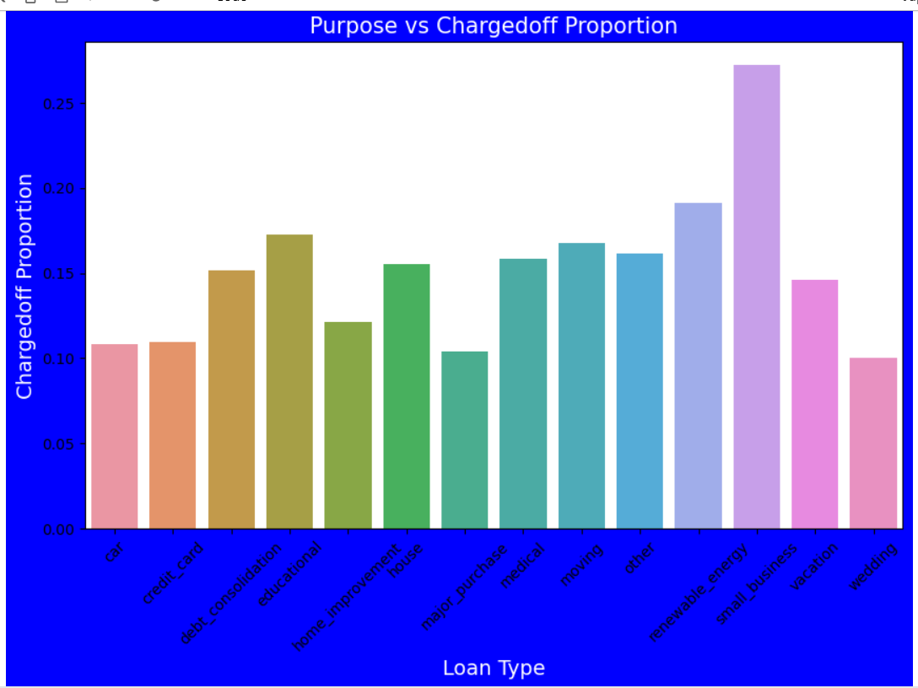
Loan Type Vs Charged Off
Applicants who is having home loan is having low chances of charged off.
Those who took loan for small business is having high chances of charged off.

Slide 10
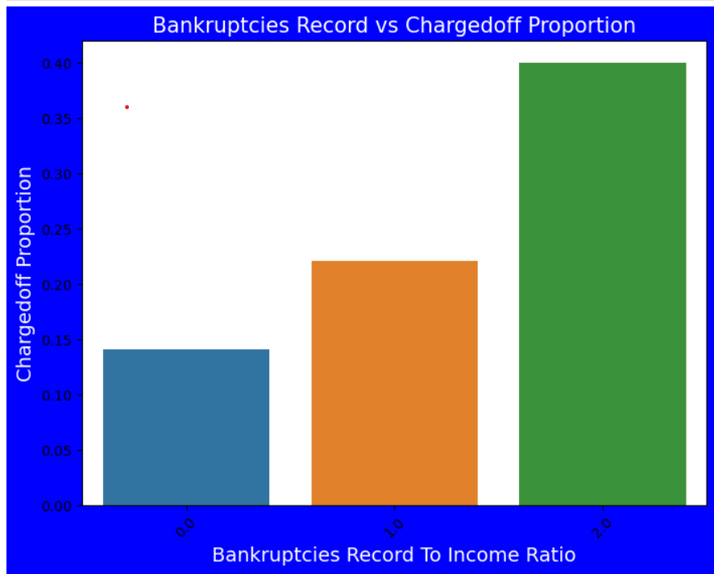
Bankruptcies VS Charged Off
Bankruptcies with 2 is having high impact on loan defaults
Bankruptcies Record with 0 is low impact on loan defaults
Lower the Bankruptcies lower the risk.

Slide 11
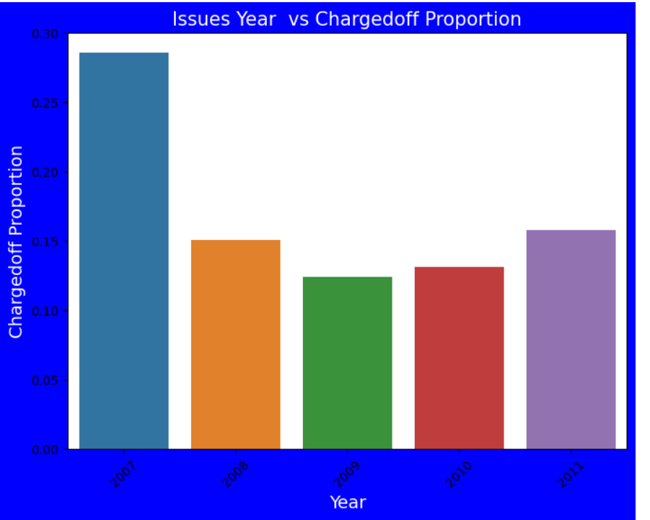
Issue Year Vs Charged Off
Loans issued in 2007 has highest loan defaults

Slide 12
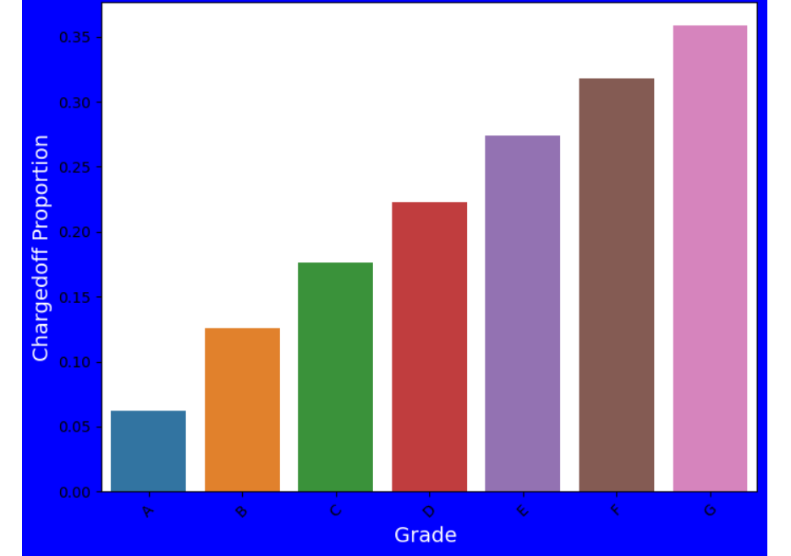
Grade Vs Charged Off
Applicants with grade G has highest loan defaults

Slide 13
Conclusion
Applicants whose income range is between 0-20000 has high chances of charged off.
Interest rate more than 16% has high chances of charged off.
Applicants who are on rent or mortgage has high chances of defaulters.
Applicants who has bankruptcy record has high chances of defaulters.
Loan applicants who got loan in 2007 has high chances of charged off.
Loan applicants with Grade G has high chances of charged off.

